Slide 1
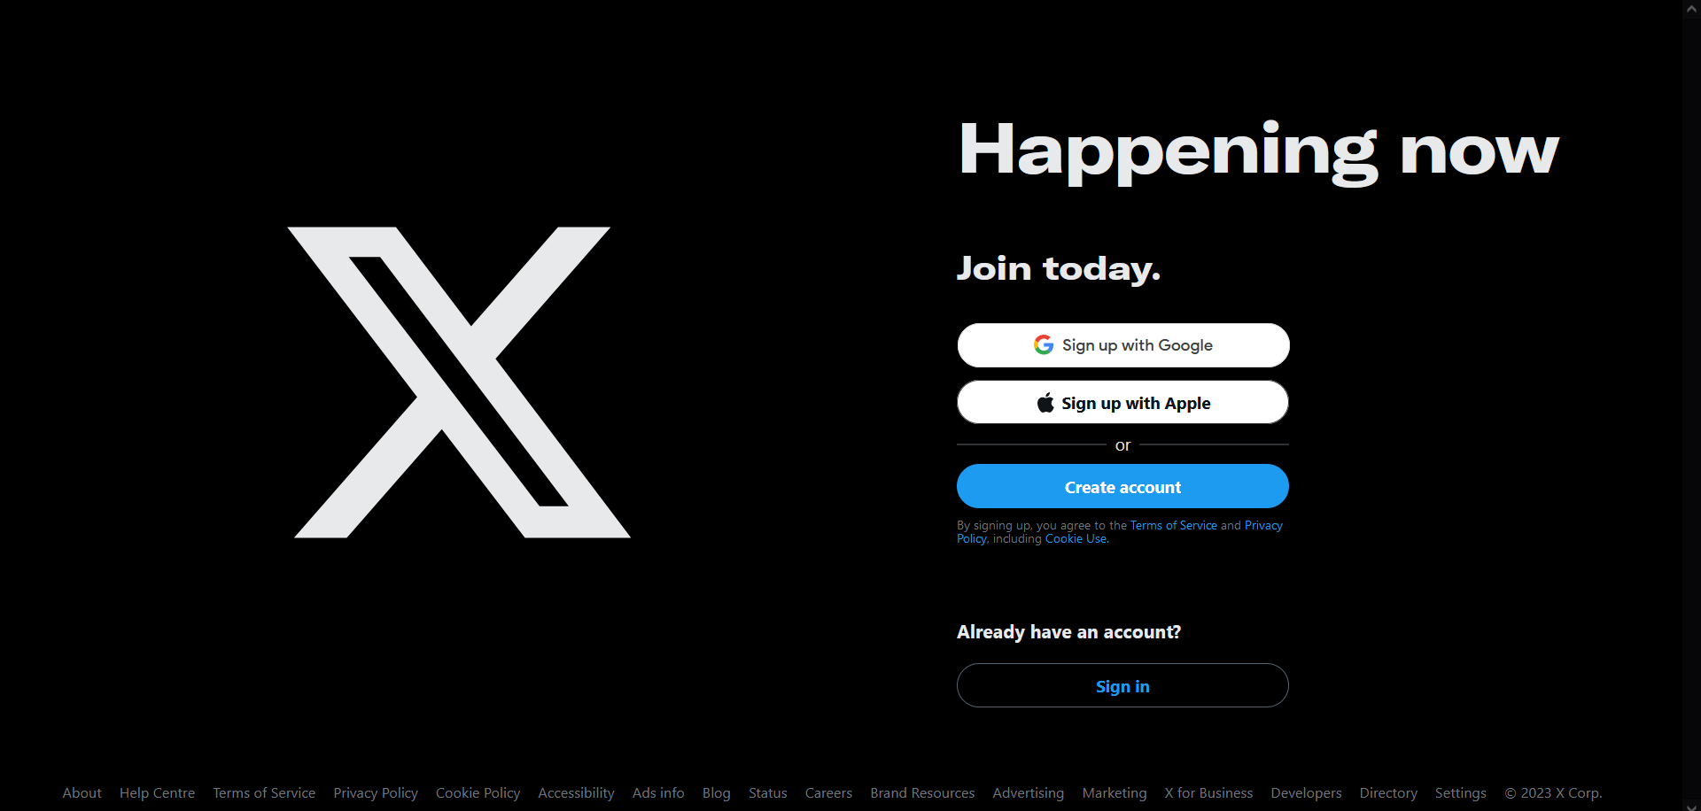

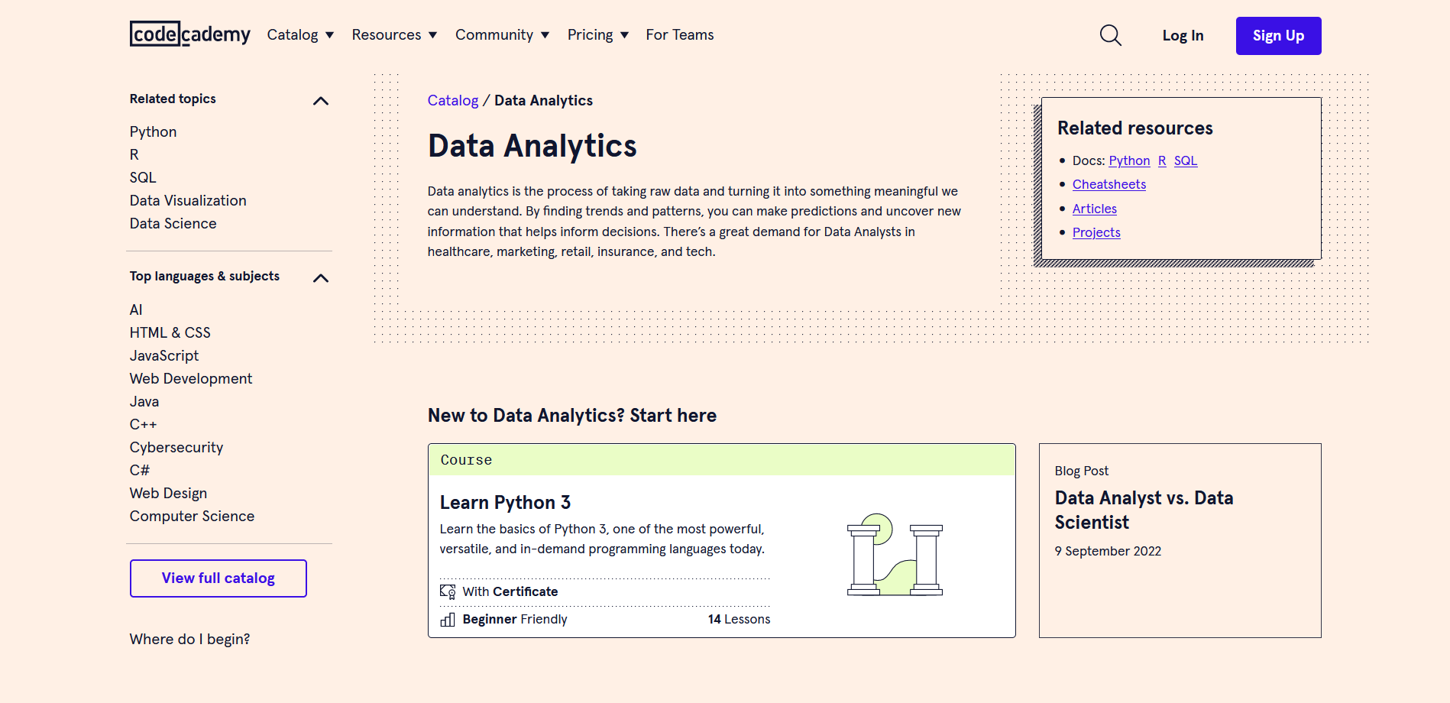
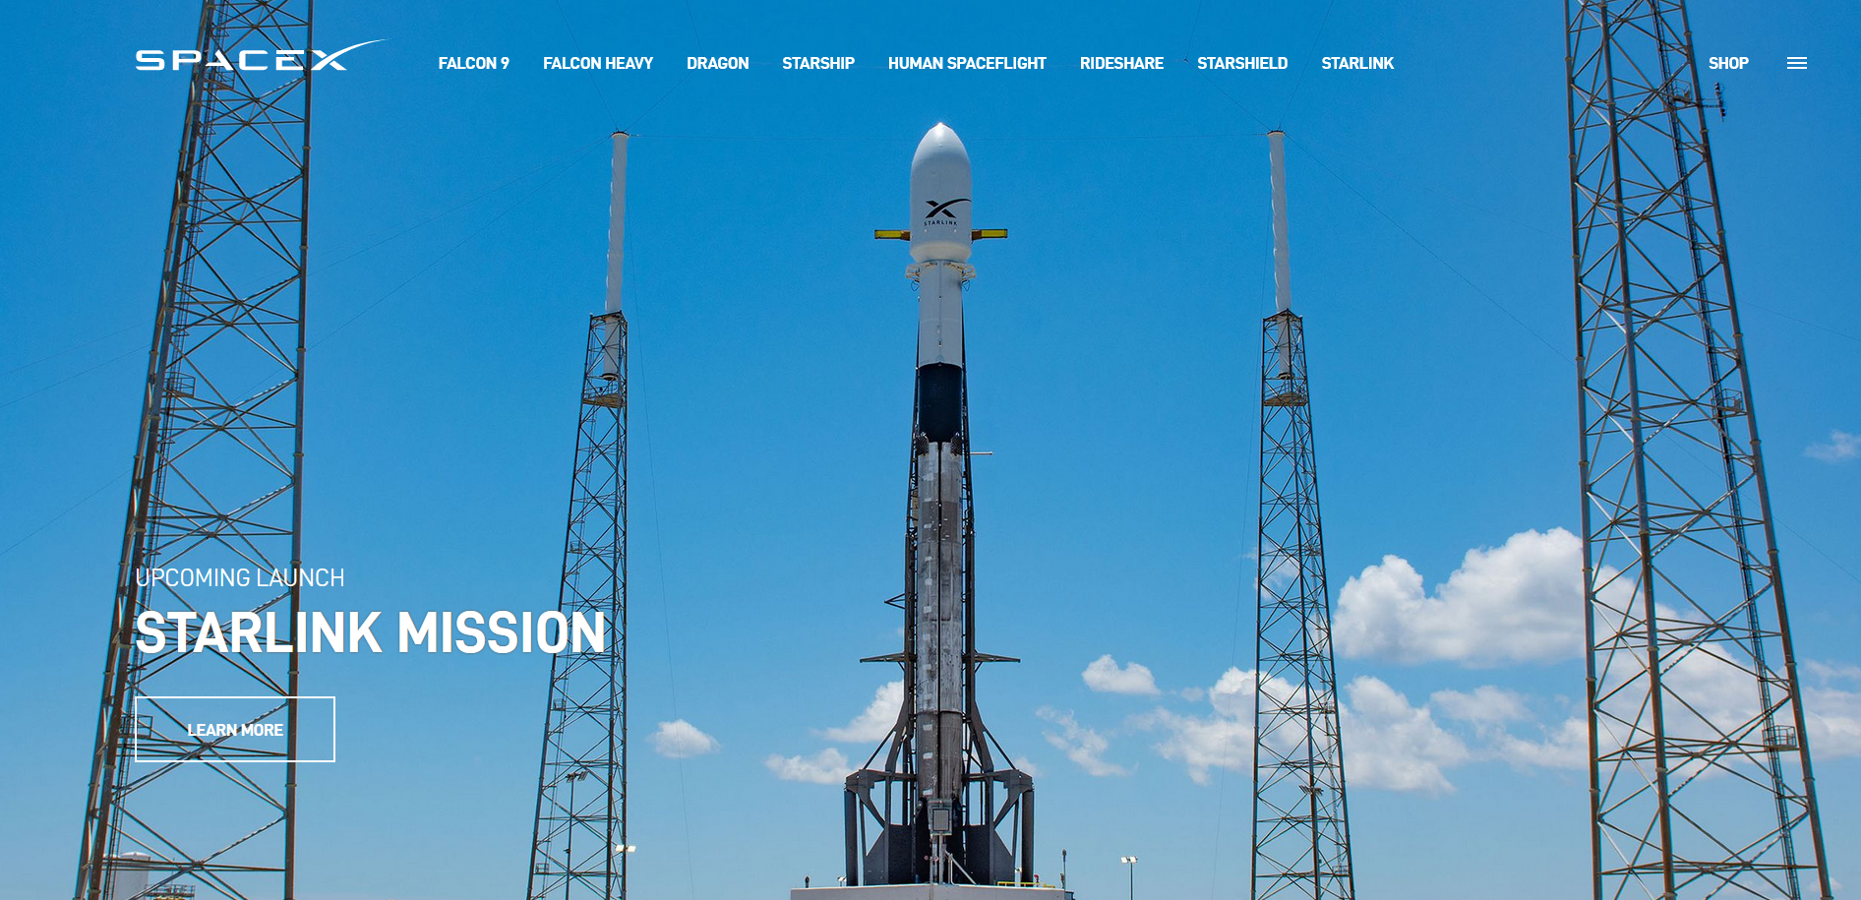

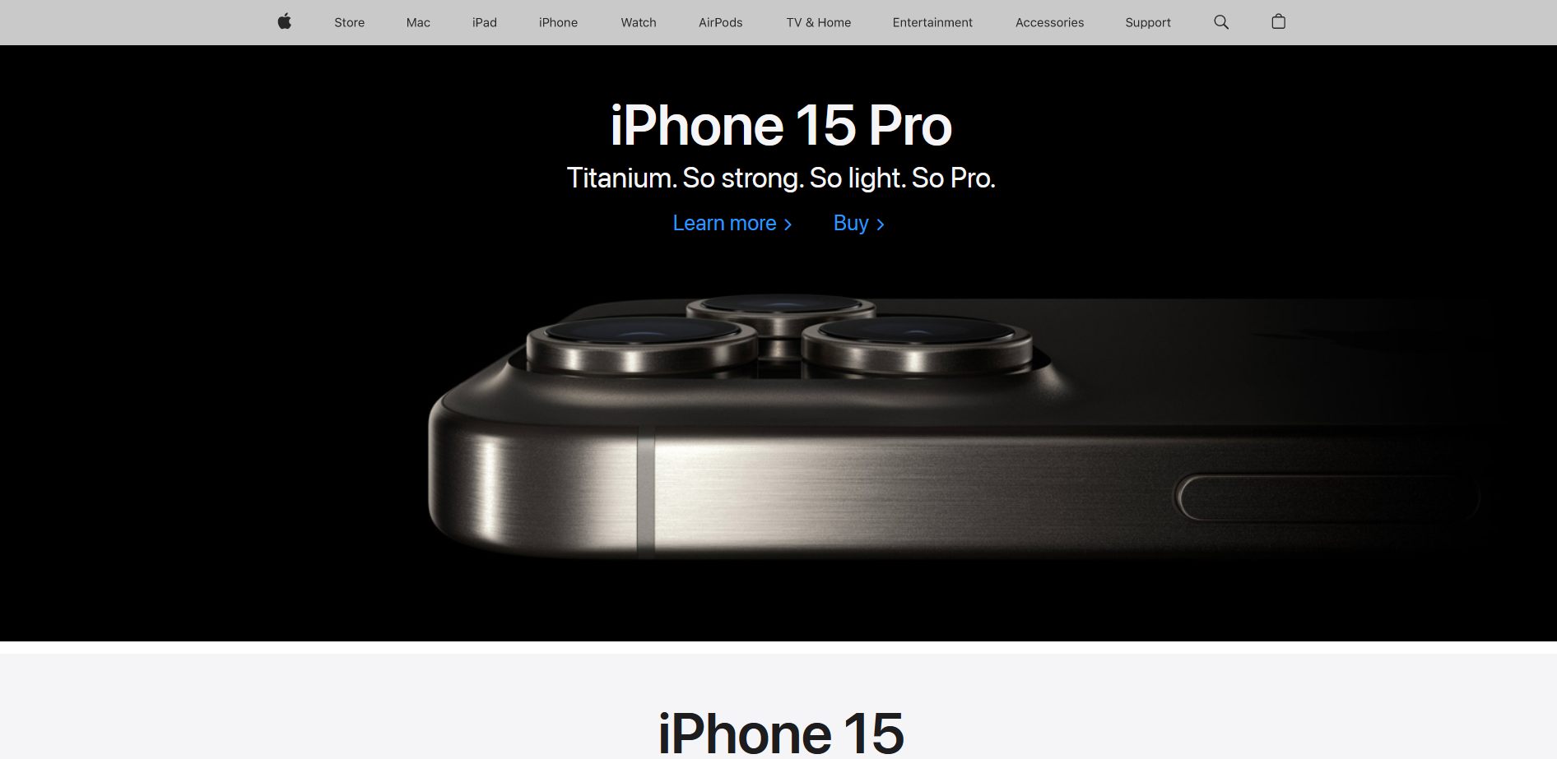
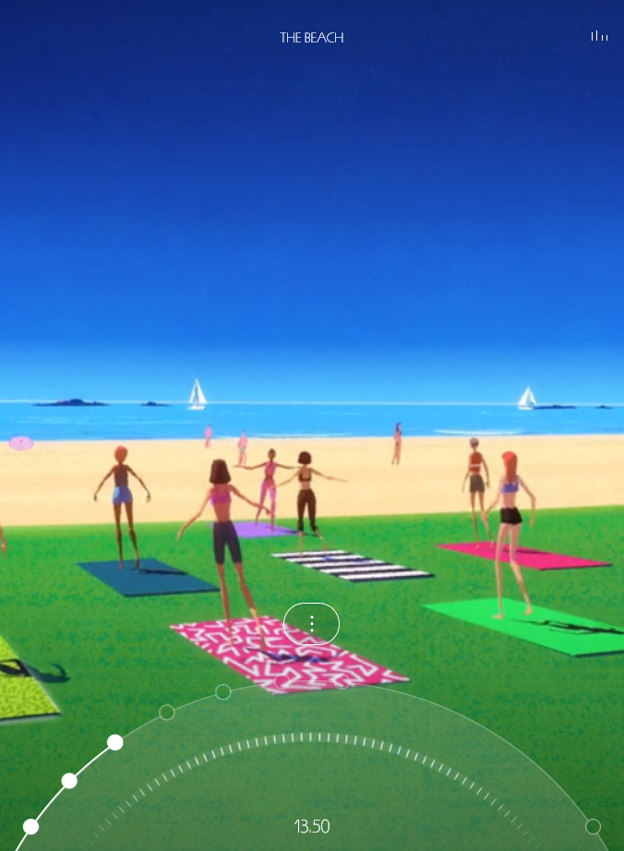
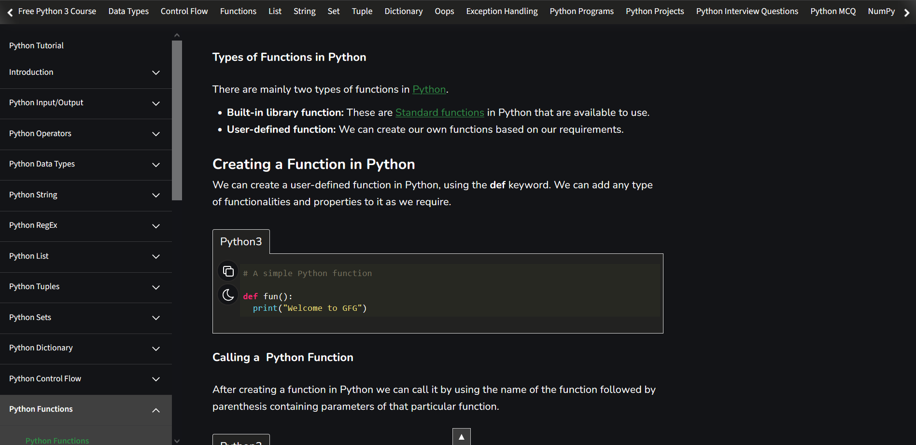
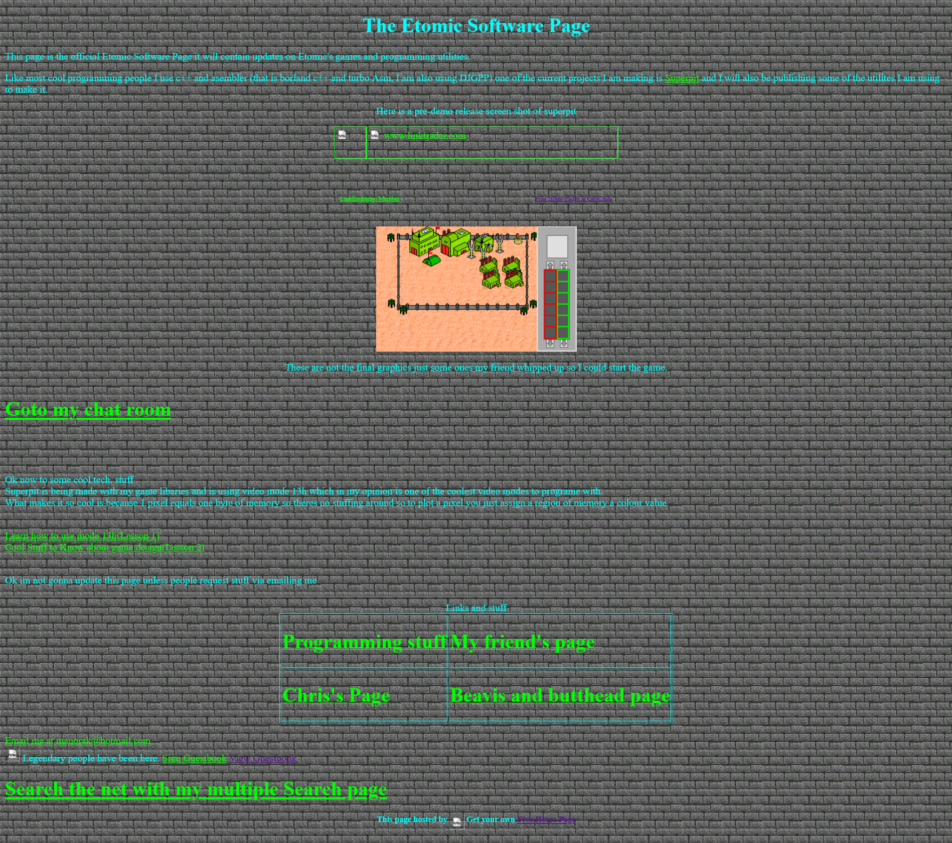
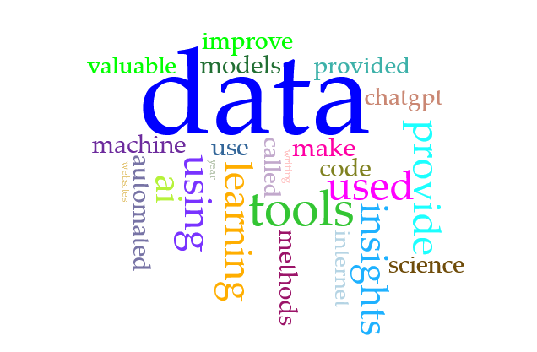
black + white, high contrast, space-age feel
minimal, sleek, large photos used with intent
artificial intelligence
drop-down menus
vintage computer console style
audio needs to be used with intent to enhance user experience and comprehension
avoid bad design, overuse of colours, text as images and low resolution
tech industry
BIG DATA
use images to improve aesthetic feel for users. to convey values of the project – cutting-edge technology, professionalism, bright future (top left)
avoid audio use for the sake of it if it does not add anything. Only serves to distract users
40 trillion gigabytes per year
Data Storytelling…
INSIGHTS
Data-driven decisions

